Slide 1
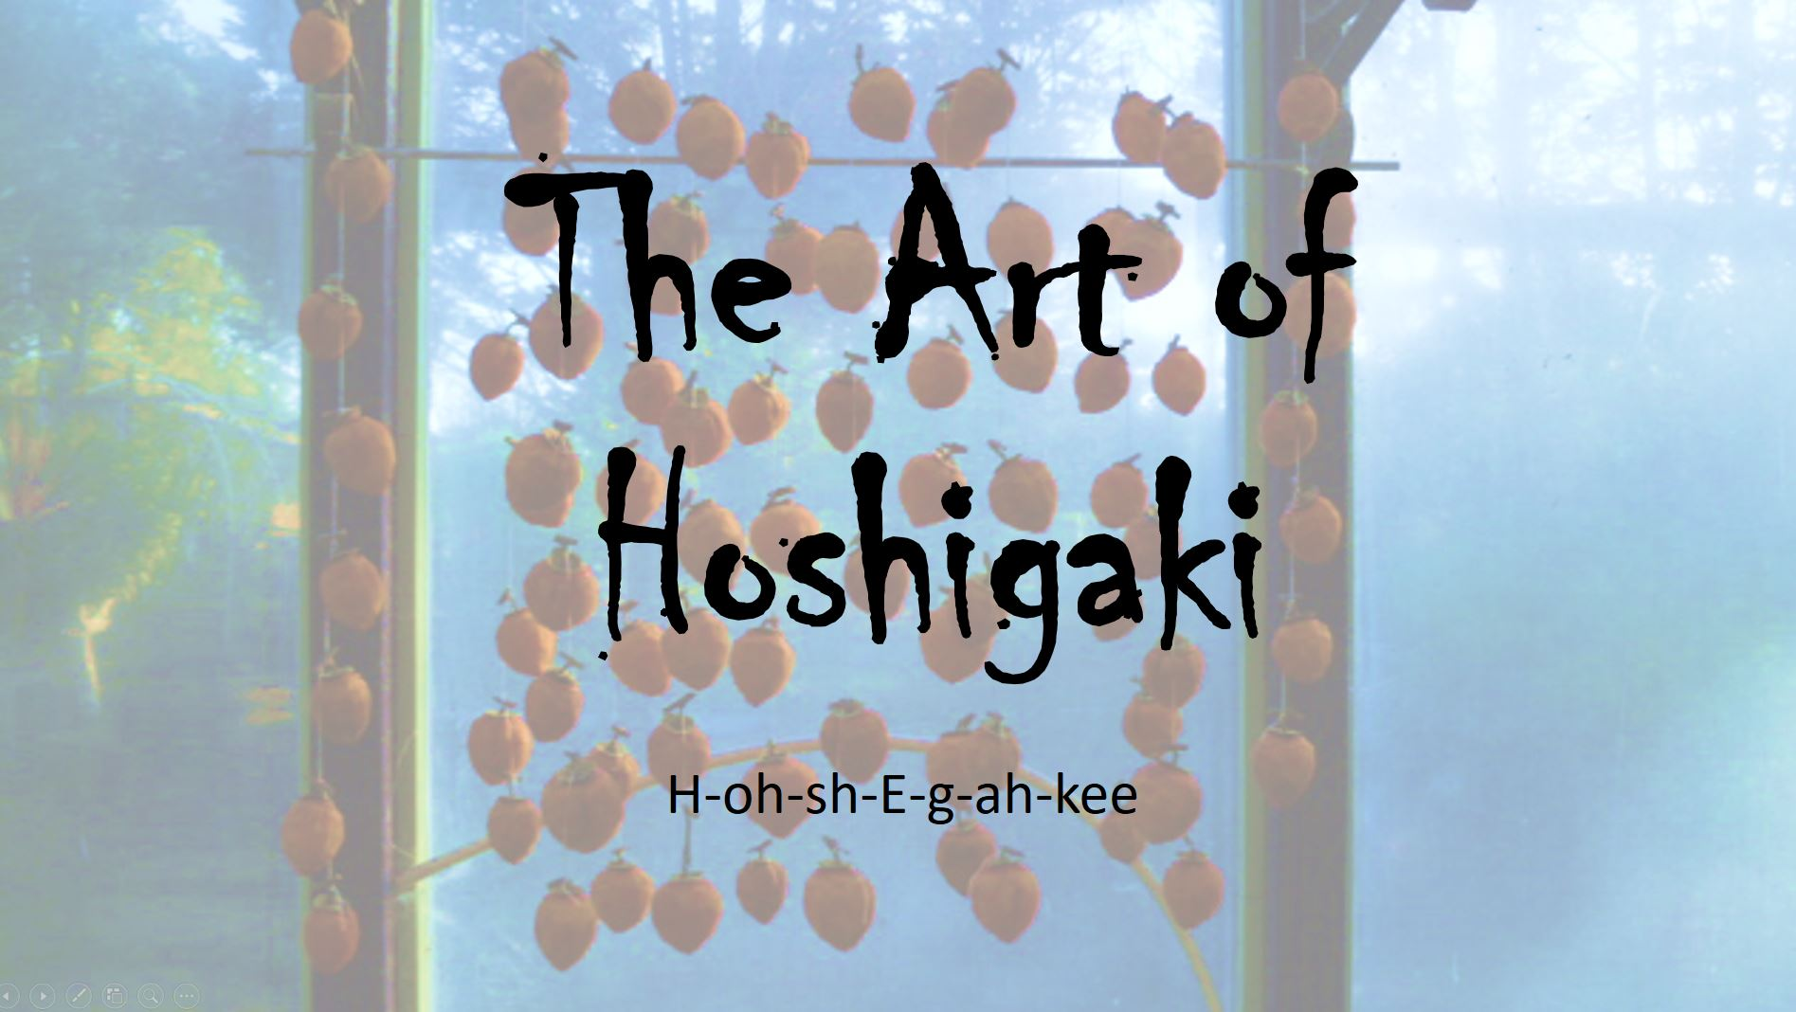

Slide 2
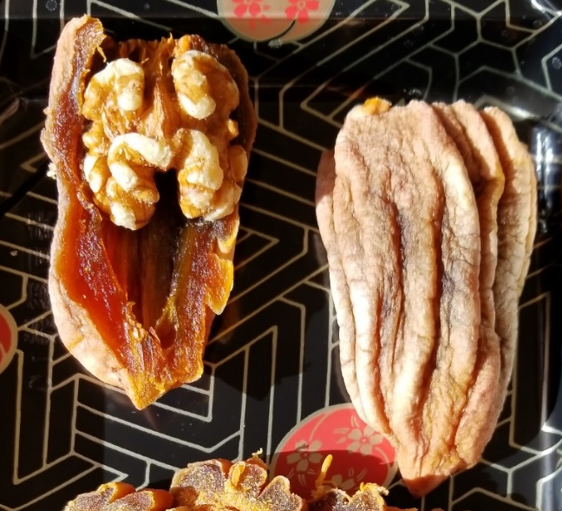
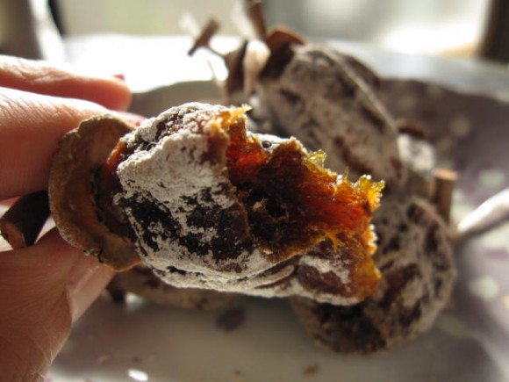
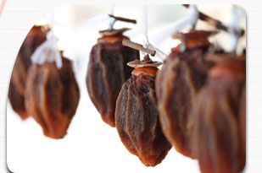
Presented by
Jenny Weaver
Carol Scott
Linda Robertson

Slide 3

Pronunciation

Slide 4
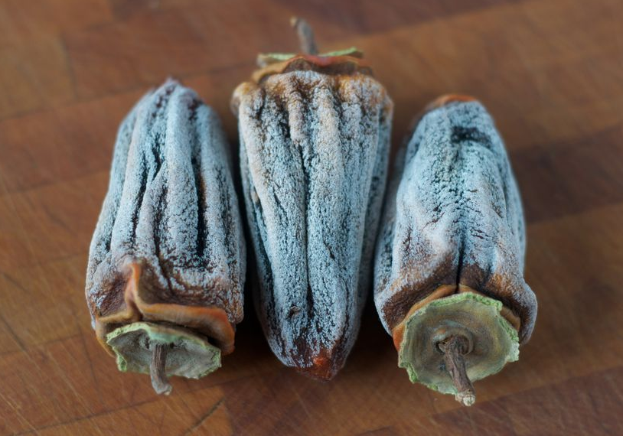
What is Hoshigaki?
The Japanese have made Hoshigaki for centuries.
It is the “art” of drying Hachiya persimmons.
The technique was developed as a way to save fresh fruit for winter.
Hard persimmons are hung for a few weeks to dry.
“Massaging” helps to create a distinctive shape and texture.
The natural sugars create a frost on the outside.
The hard Hachiya persimmon is transformed into a chewy delicacy that has been described as “intense—concentrated persimmon flavor with honeyed overtones and perhaps the barest hint of cinnamon and a chewy texture with almost jelly-like insides.”

Slide 5
Names for Dried Persimmon
Japan hoshigaki
China shìbìng
Korea gotgam
Vietnam hông khô

Slide 6
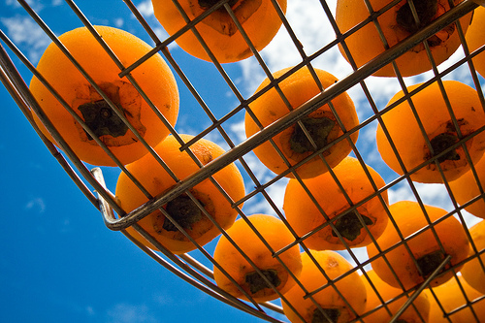
Korean and Chinese Drying Methods
Made with Fuyu persimmons
The fruit is not massaged
It dries on baskets and gets a "squished" disc shape
Retail price usually under $1 each (hoshigaki usually about $4 each)
Quality and flavor are usually inferior to Hoshigaki

Slide 7
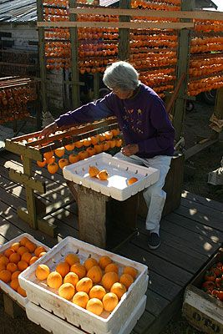
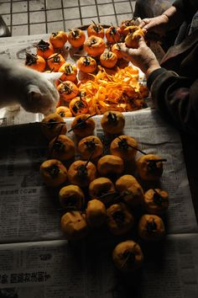
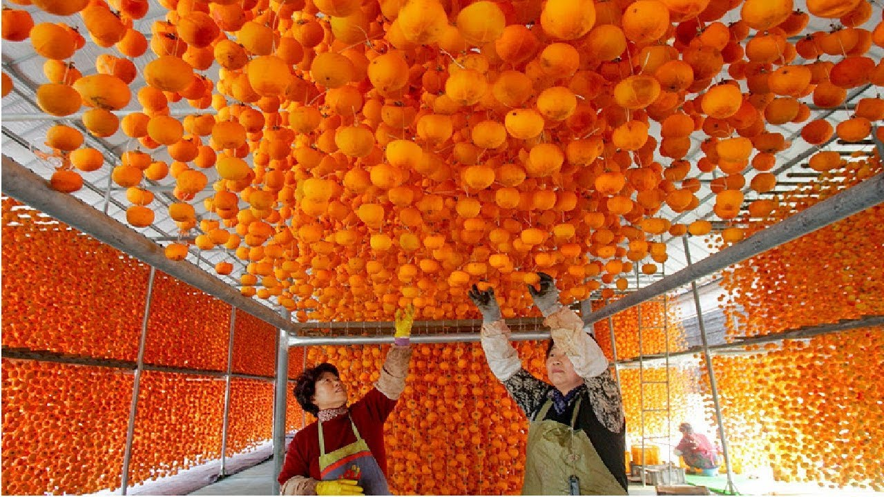
Making Hoshigaki

Slide 8
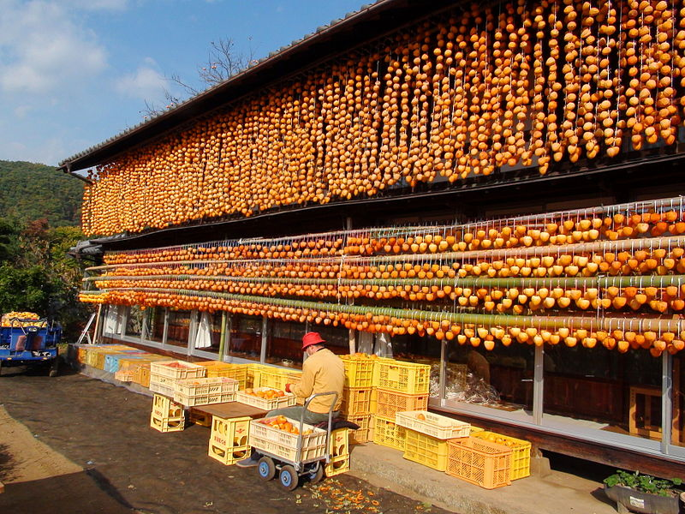
Making Hoshigaki

Slide 9
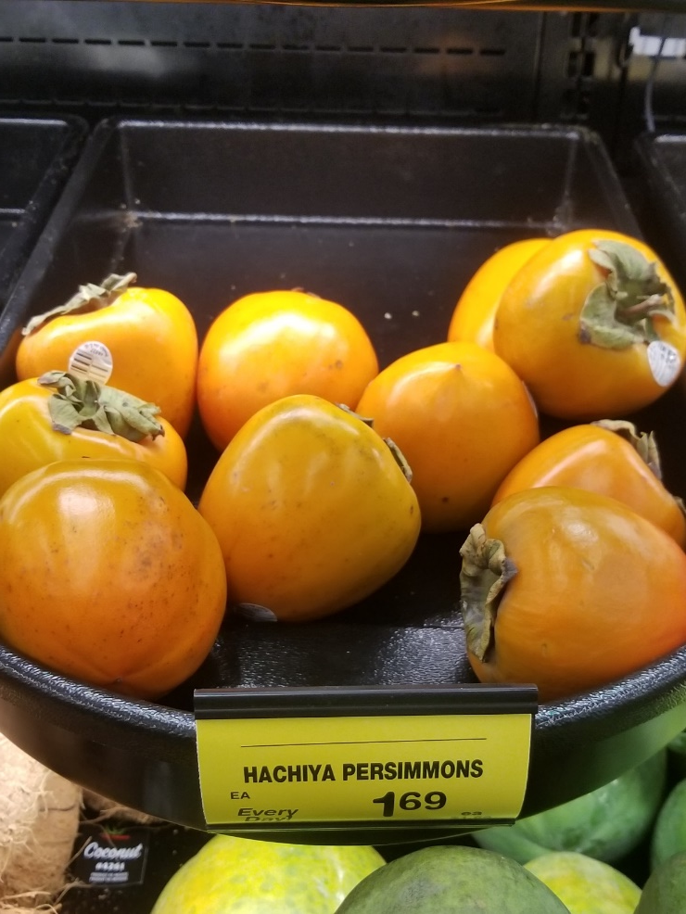
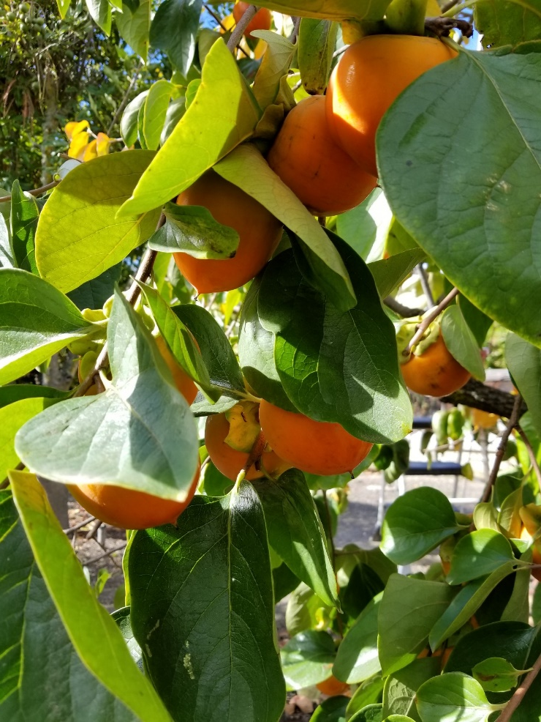
Steps for Making Hoshigaki
Step 1: Get hard Hachiya persimmons

Slide 10
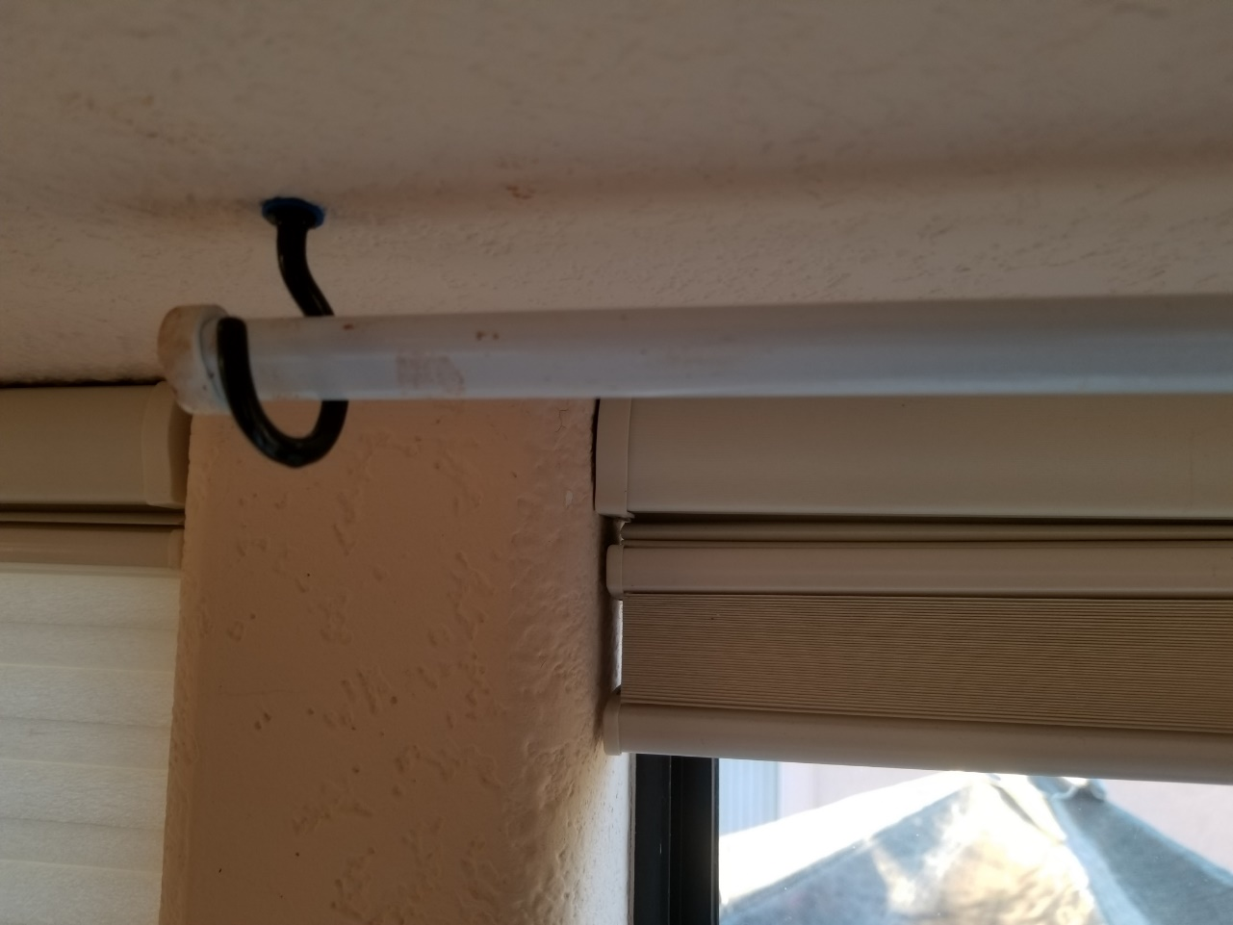
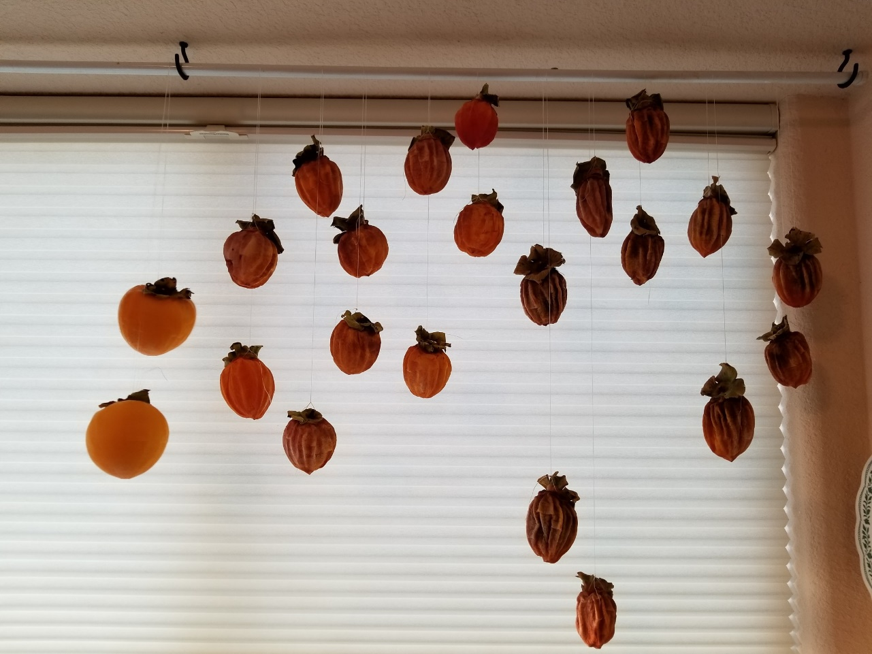
Step 2: Setup drying rods or racks
Jenny’s setup– hanging from a curtain rod in a south-facing window

Slide 11
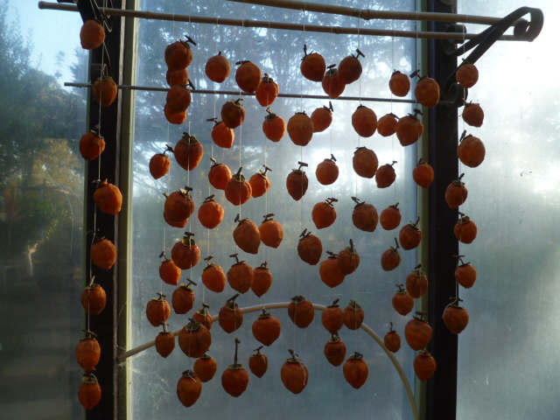
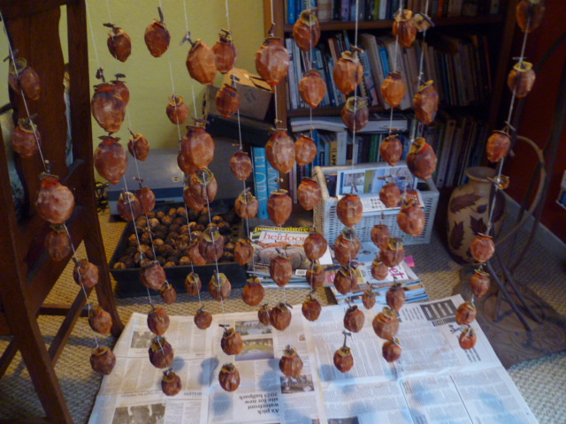
Step 2: Setup drying rods or racks
Carol’s setup– Greenhouse and inside the house

Slide 12
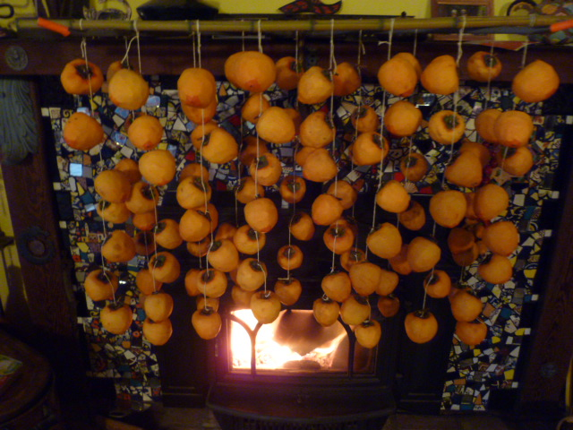
Step 2: Setup drying rods or racks
Carol’s setup– By the fireplace

Slide 13
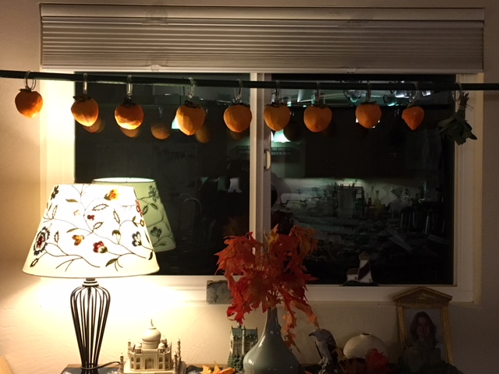
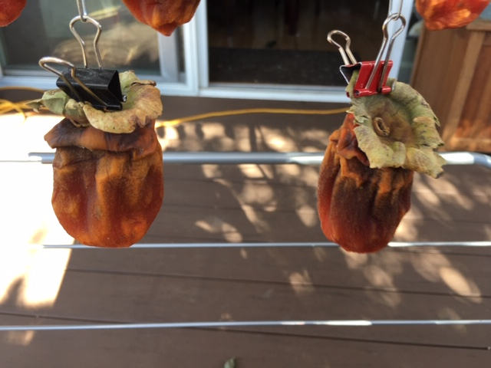
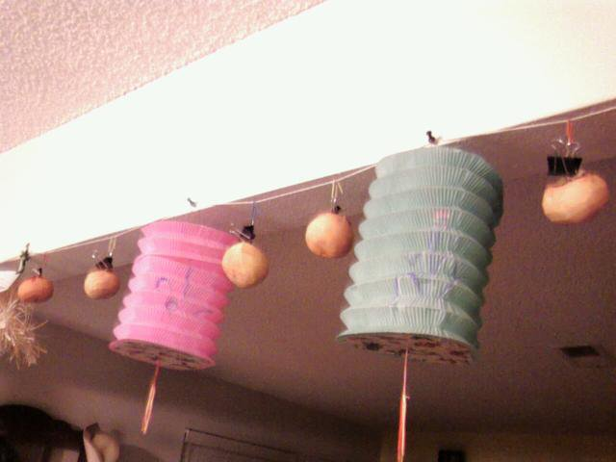
Step 2: Setup drying rods or racks
Linda’s setup– In the living room and outside, with clips.

Slide 14
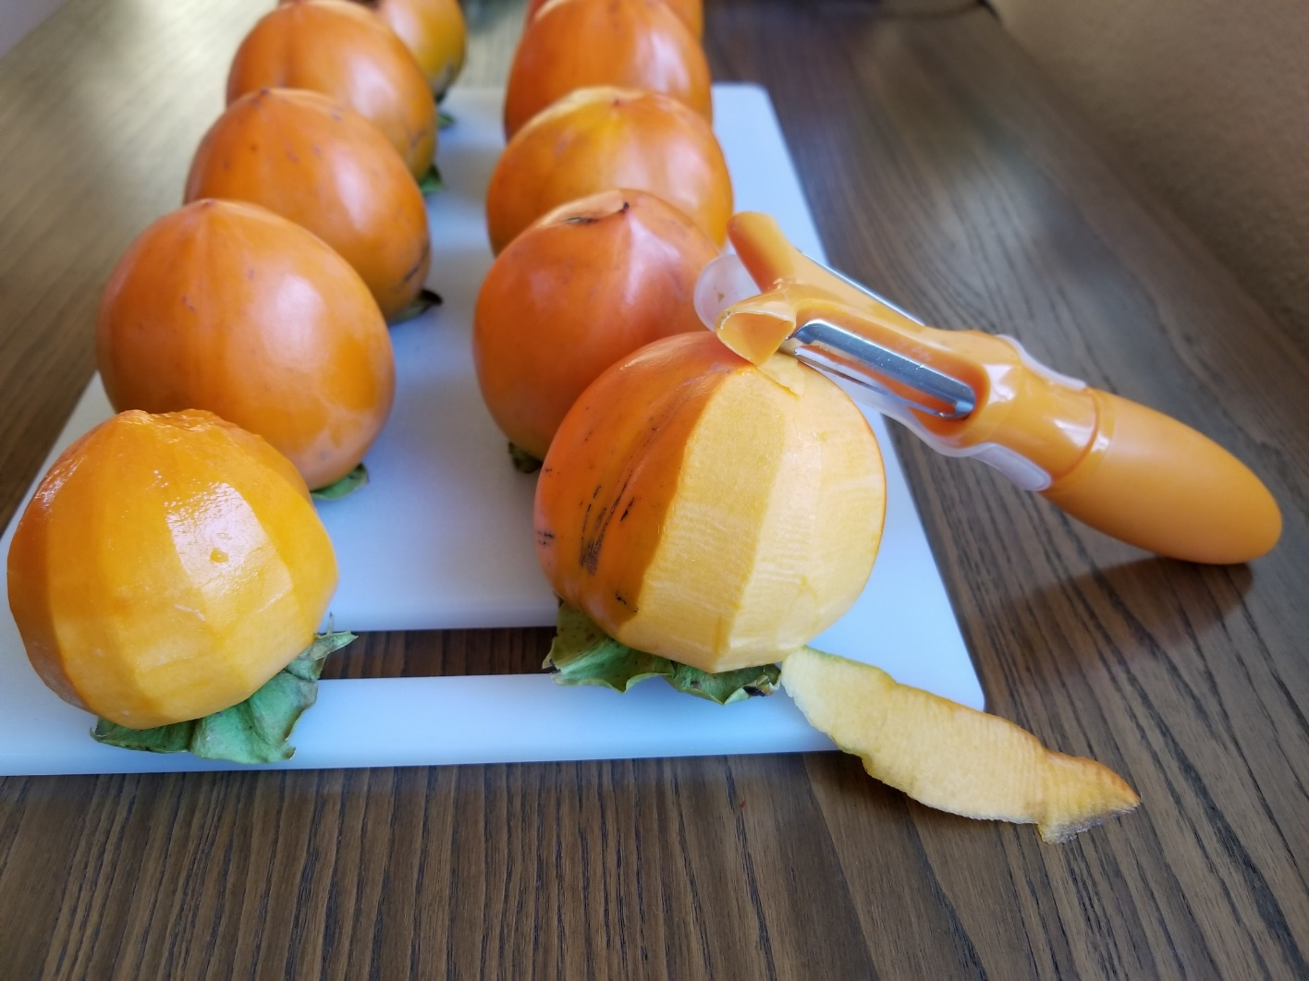
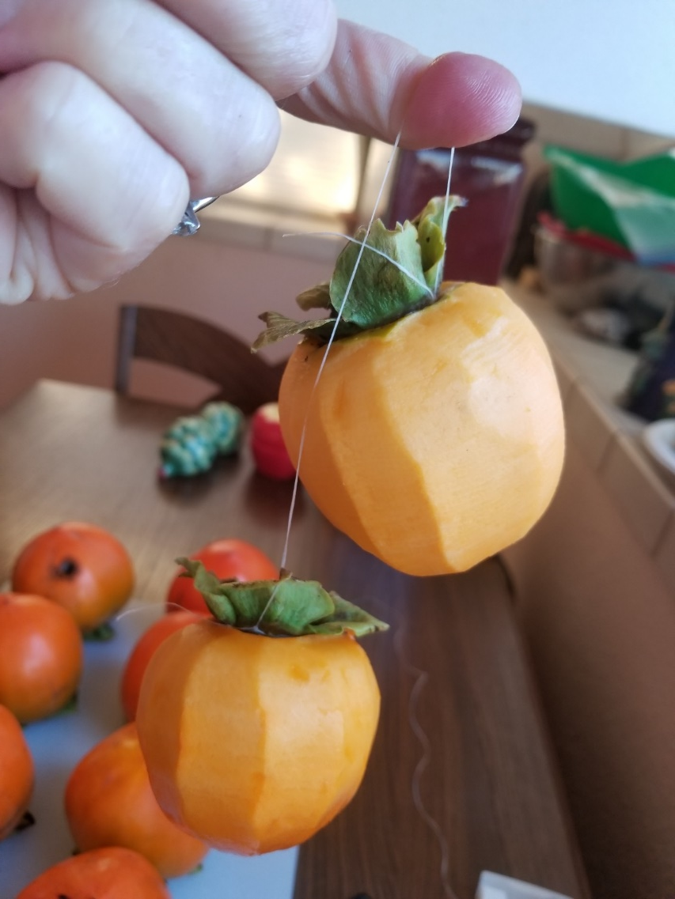
Step 3: Wash, peel, attach string or clips
Dental floss works great! Jenny puts the floss under the calyx.

Slide 15
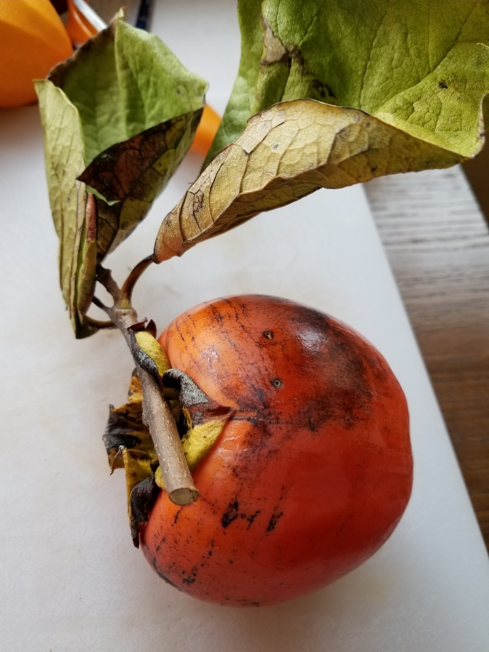
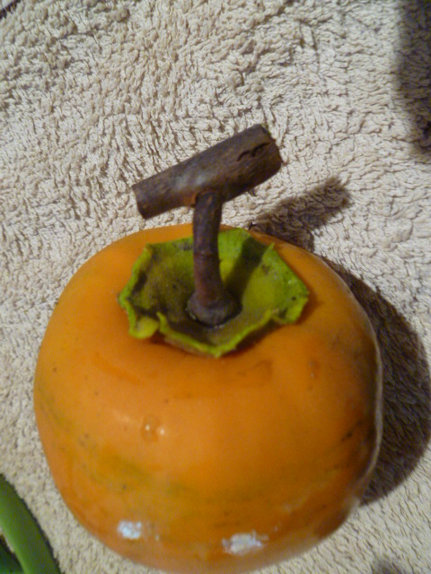
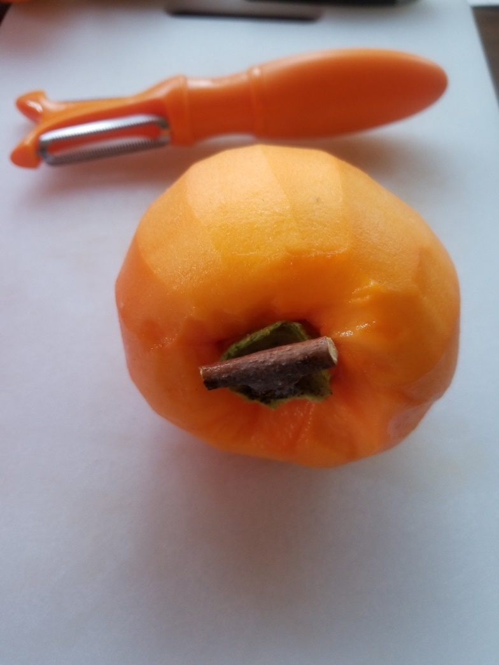
Step 3: Wash, peel, attach string or clips
Carol’s setup– Prune the branch and create a T for attaching the string.

Slide 16
Step 3: Wash, peel, attach string or clips
If you choose to leave the Calex attached, be sure to wash under each one. Mealy bugs will hide there.
Linda’s setup– Attach with binder clips and paper clips.

Slide 17
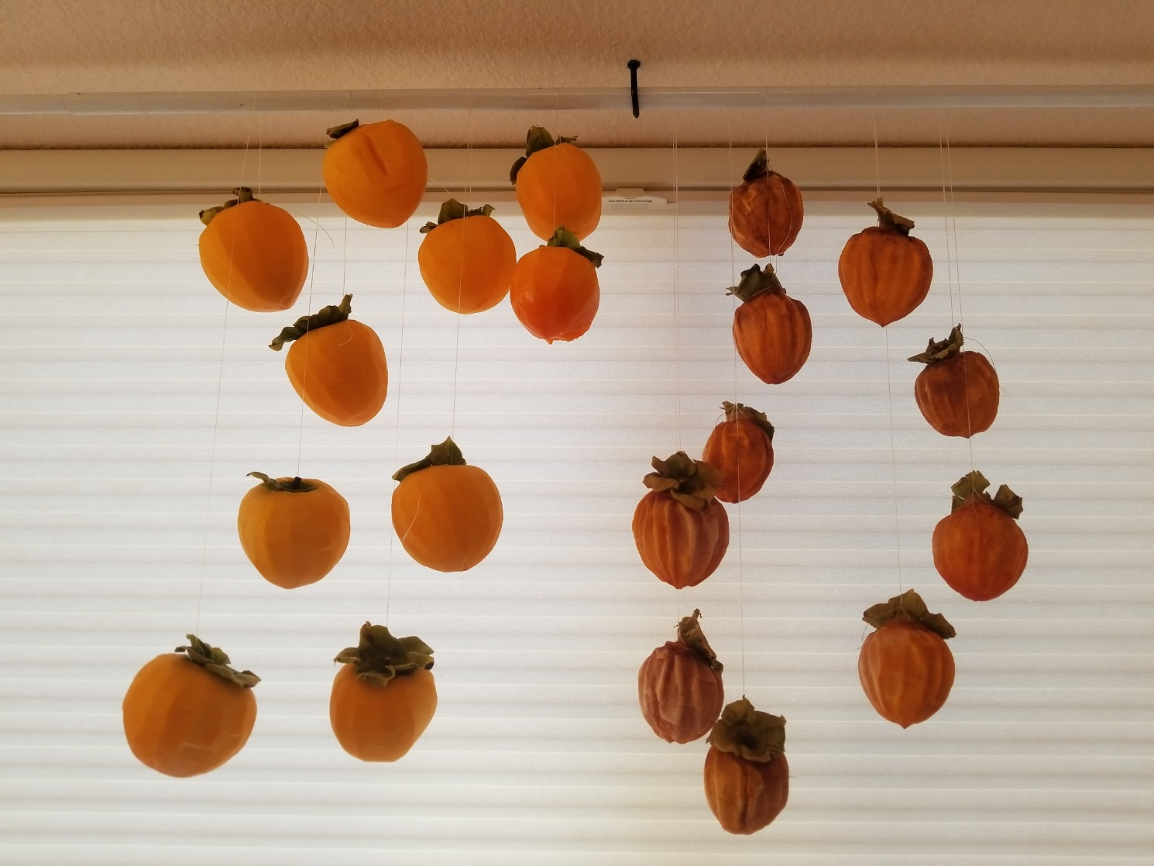
Step 4: Hang the fruit
Mold is the enemy
Carol suggests that some lemon juice on a q-tip might halt mold.
Drying persimmons should never touch each other.
Allow air to circulate around the entire fruit. If you have a damp/cool condition, consider a fan for better circulation.
You can tie one to each end of a string and loop over the rod. Work in stages. These are a week apart in the drying process.

Slide 18
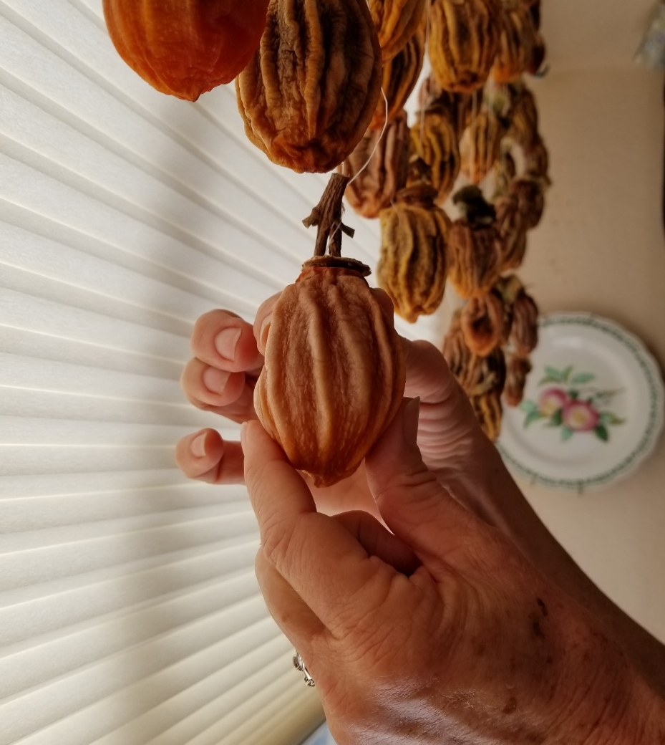
Step 5: Massage the fruit
After hanging, wait a week, then gently massage the fruit every two to three days for three to five weeks. If you live in a cooler climate this could take longer.

Slide 19
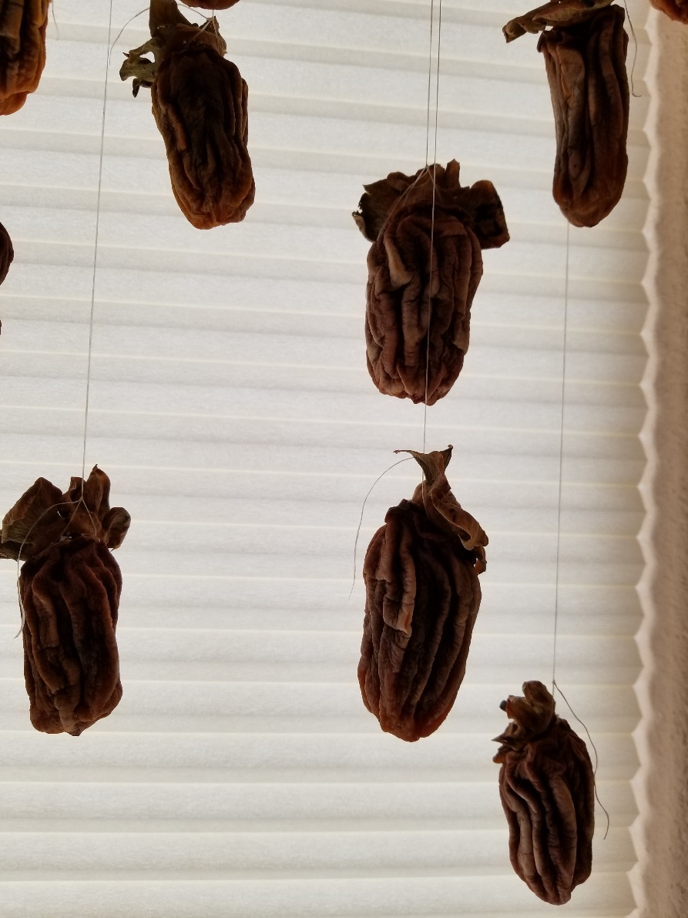
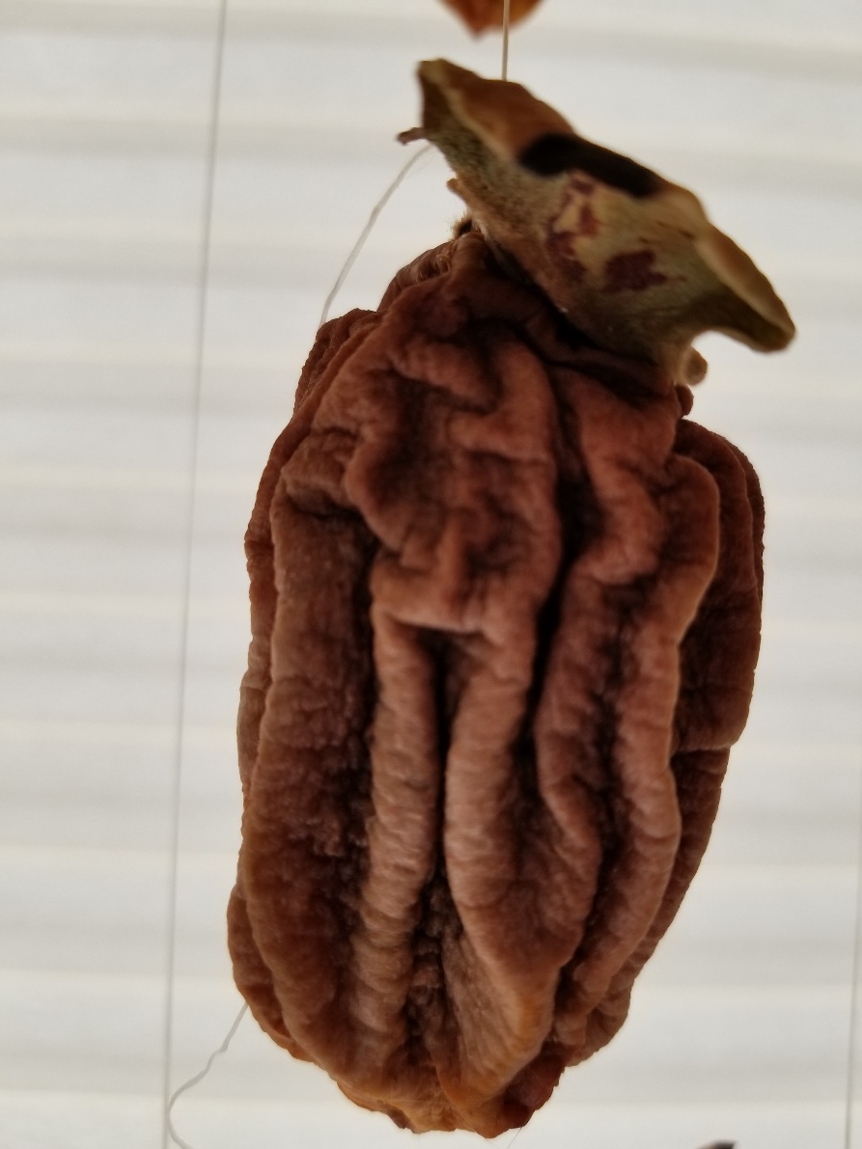
About Ready to Eat!
Not too hard, not too soft.

Slide 20
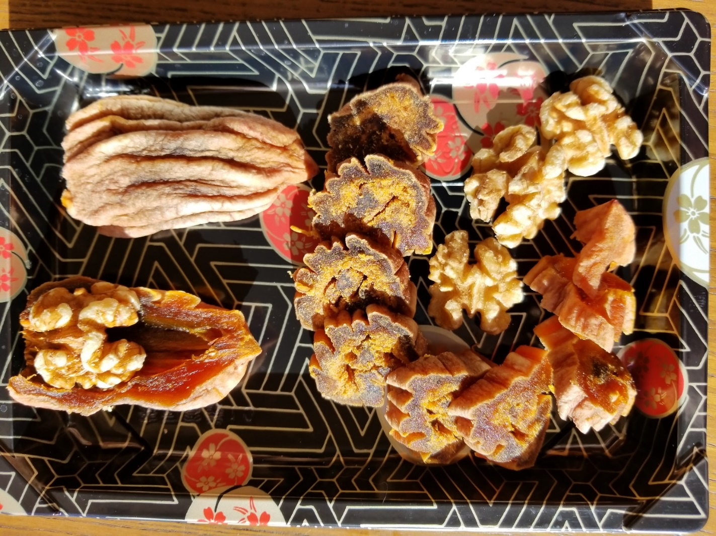
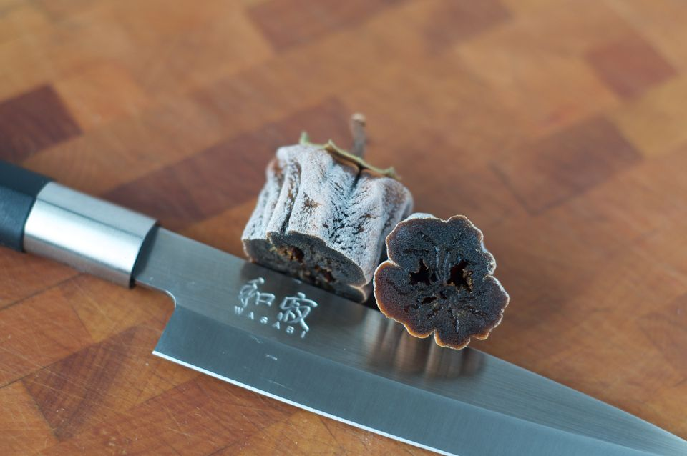
Serving Hoshigaki
Gotgam-ssam (fruit-wrapped walnut)

Slide 21
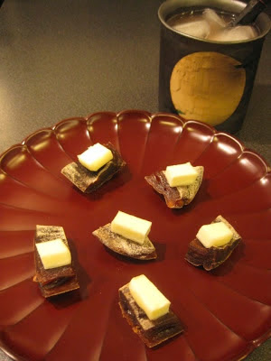
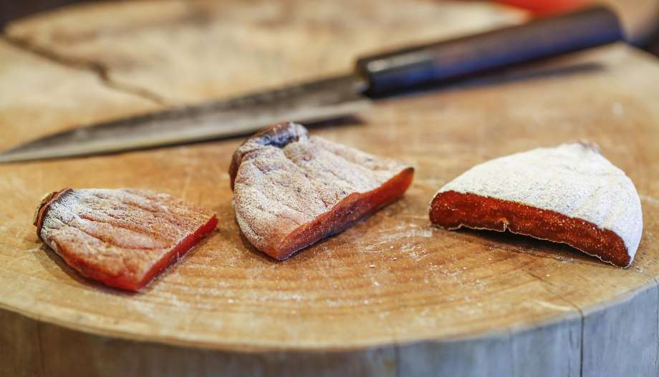
Serving Hoshigaki
Hoshigaki with butter or cheese

Slide 22
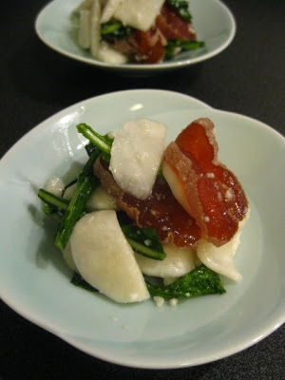
Hoshigaki and Kabu
by Naoko
Naoko, author of DONABE (clay pot) cookbook suggests serving Hoshigaki with “Kabu” (Japanese turnip or Tokyo turnip).
Thin slice the Kabu and Hoshigaki
Chop up some Kabu leaves
Toss with Shio Koji
“Shio Koji (塩麹, 塩糀) is a mix of salt, water and rice koji, and it’s a natural seasoning used to marinate, tenderize, and enhance the umami, or richness (one of the five basic tastes), in foods. It’s a live food that is rich in enzymes that break down the starches and proteins in food into sugars and amino acids.”

Slide 23
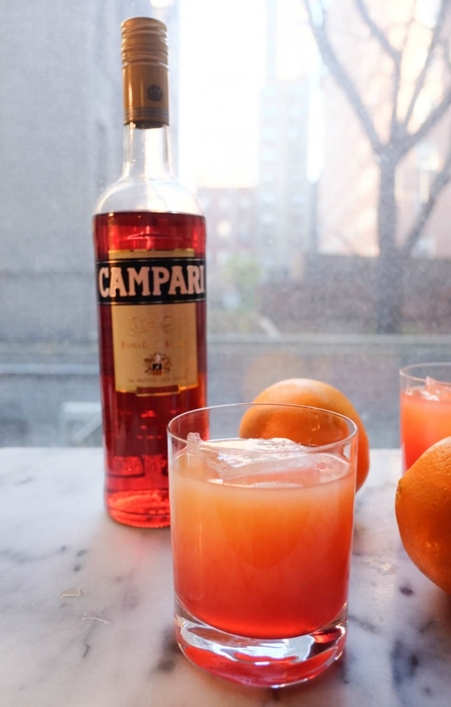
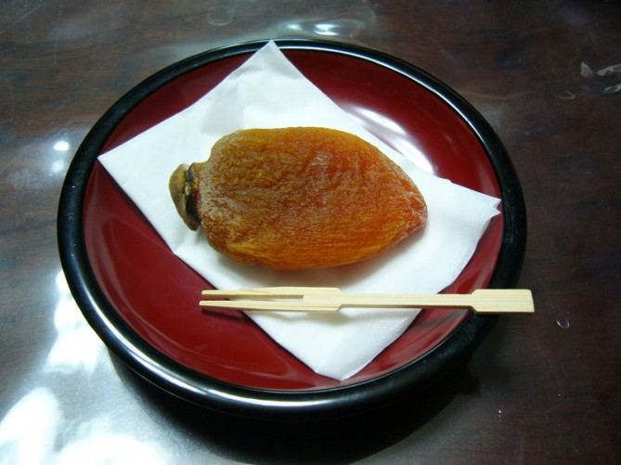
Naoko also suggests pairing with a cocktail made from Compari and orange juice

Slide 24
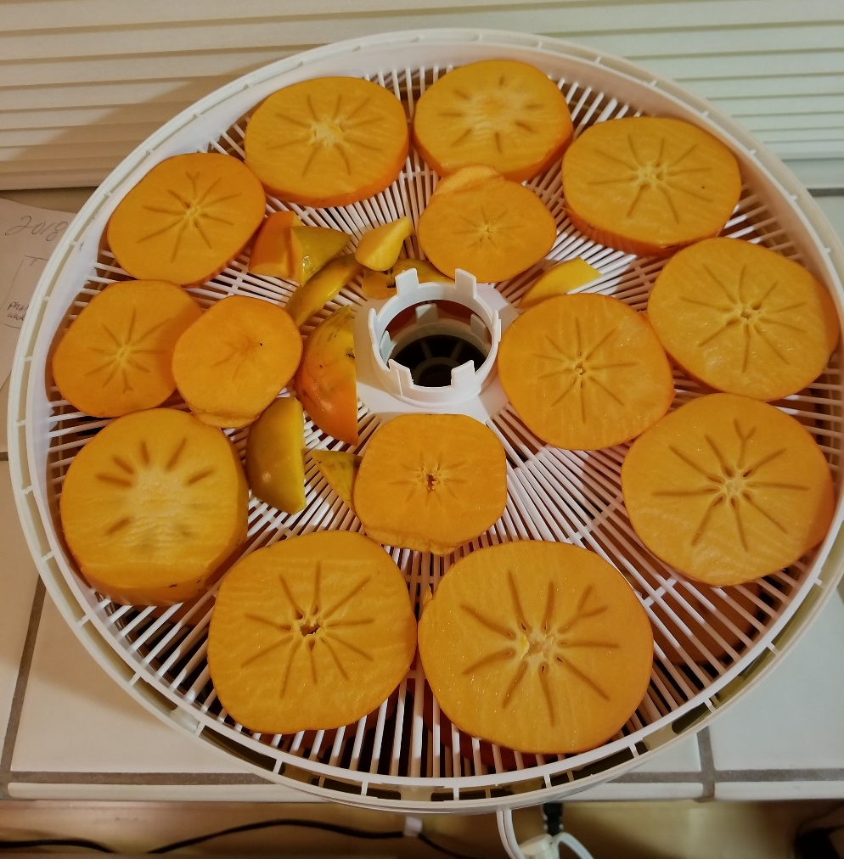
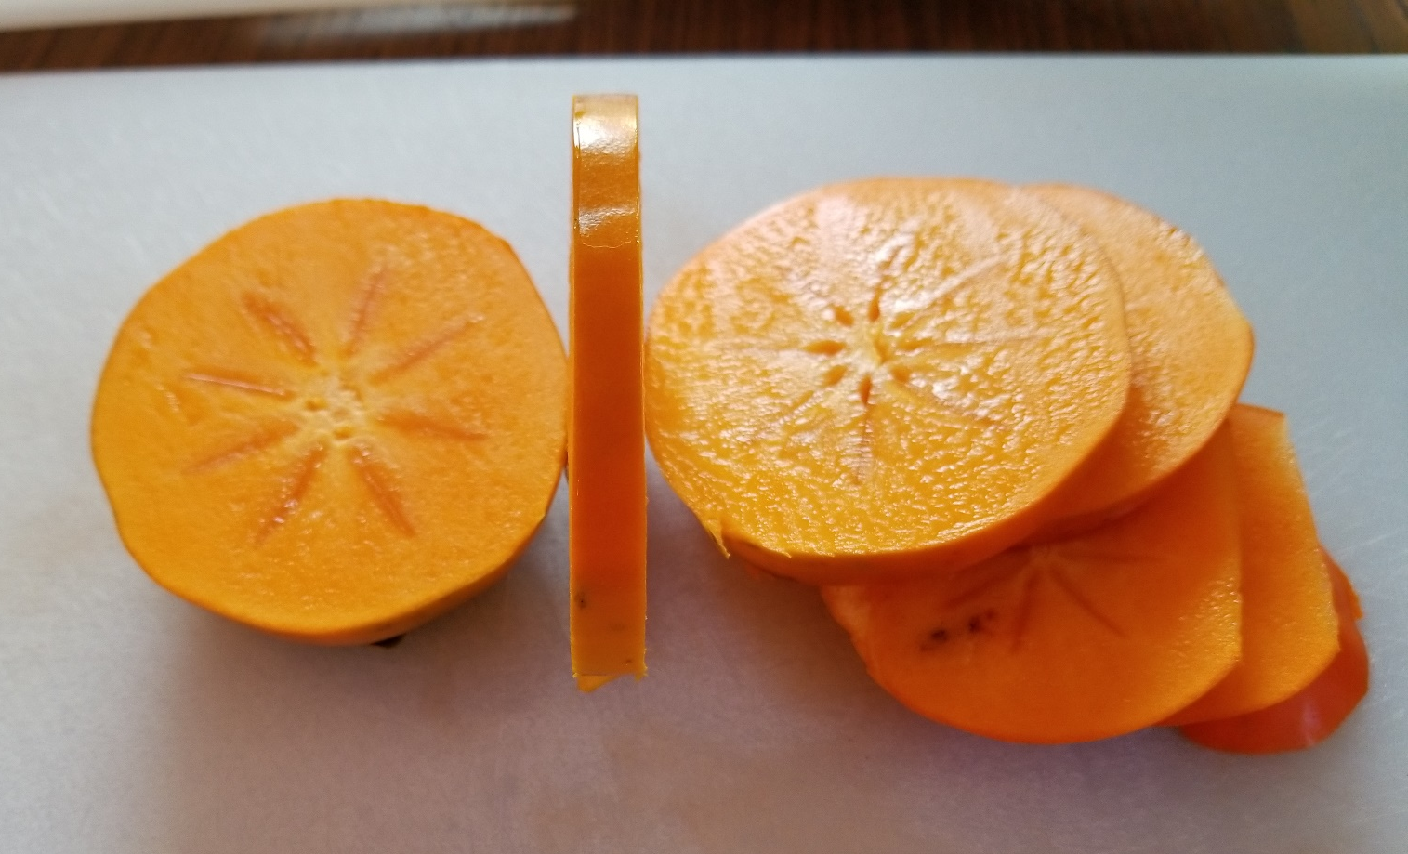
Hachiya slices in a dehydrator
Don’t want to wait five weeks for Hoshigaki? Slice hard Hachiya persimmons about 3/8” thick and dry them in a dehydrator about 12 hours.

Slide 25
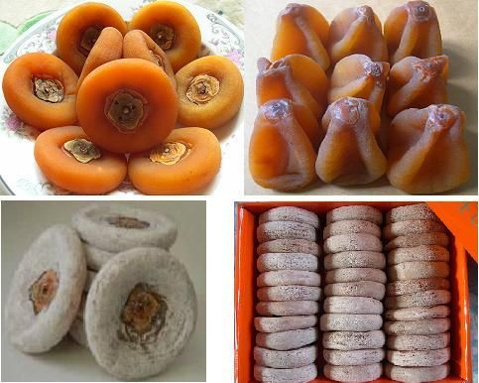
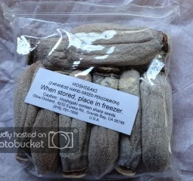
Web and Retail Sales

Slide 26
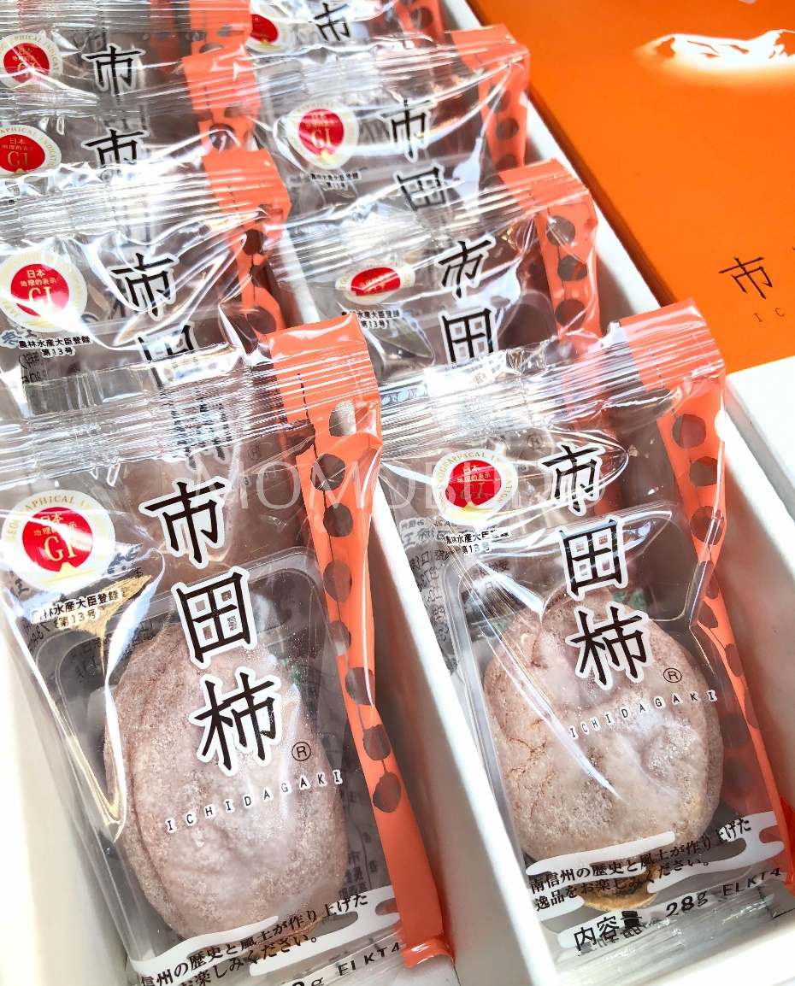
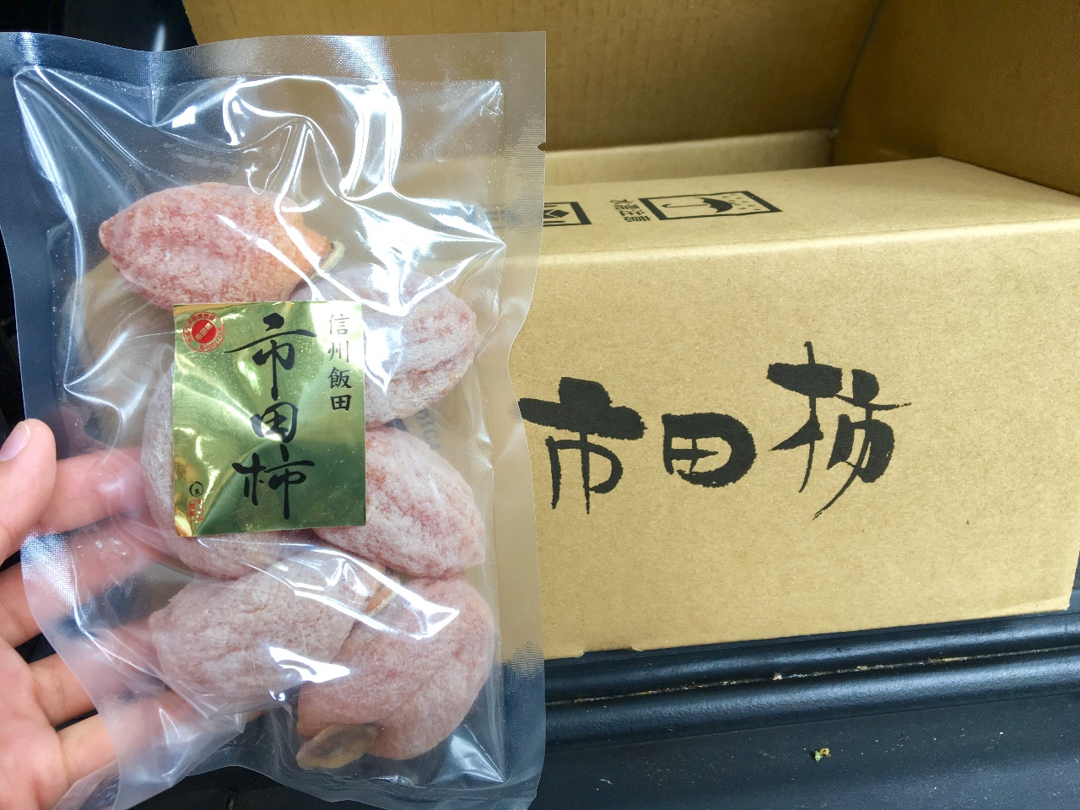
Web and Retail Sales

Slide 27
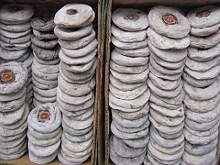
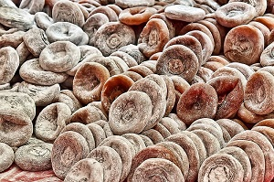
Xi’an China
Singapore

Slide 28
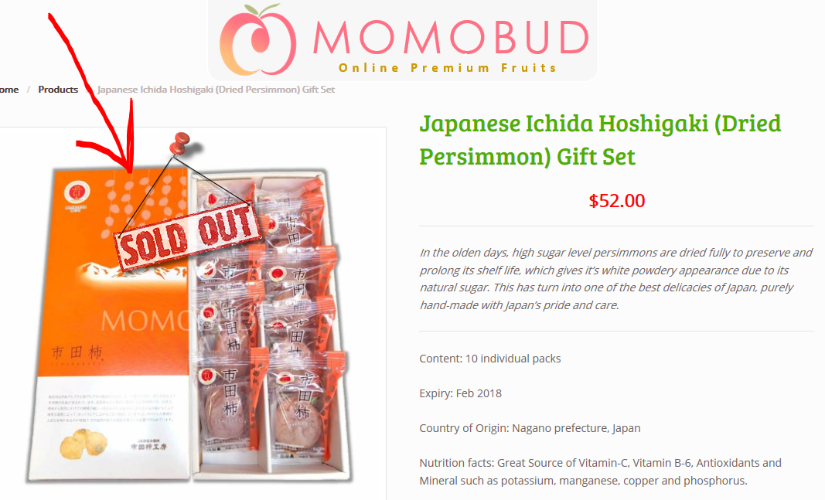
Web Sales

